Slide 1

Introduction to the
Environmental Exposures Ontology (ECTO)
Nicole Vasilevsky
May 03, 2018
MB599
vasilevs@ohsu.edu
github.com/tis-lab/mb99/ECTO_Intro

Slide 2
Environmental Exposure Ontology (ECTO)
Type of knowledge represented:
Examples:
Experimental treatments of plants and model organisms
Dietary modifications
Drug treatments
Exposures of humans or any other organisms to stressors
Noise
UV
Stimuli; natural and experimental
Light
Chemicals
Any kind of environmental condition or change in condition that can be experienced by an organism or population of organisms on earth
Climate change
Pesticides

Slide 3
ECTO is a modular ontology
What does it mean to be ‘modular’?
ExO – Exposure ontology
CHEBI – Chemical Entities of Biological Interest
ENVO – Environment Ontology
NCBI Taxon - Species
Uberon – Uber Anatomy Ontology

Slide 4
Logical definitions are constructed using other ontologies
Label: Exposure to acetone
Synonym: Acetone exposure event
Text definition: A exposure event involving the interaction of an exposure receptor to acetone. Exposure may be through a variety of means, including through the air or surrounding medium, or through ingestion.
ECTO
RO
CHEBI
'exposure event' and ('has exposure stimulus' some acetone)

Slide 5
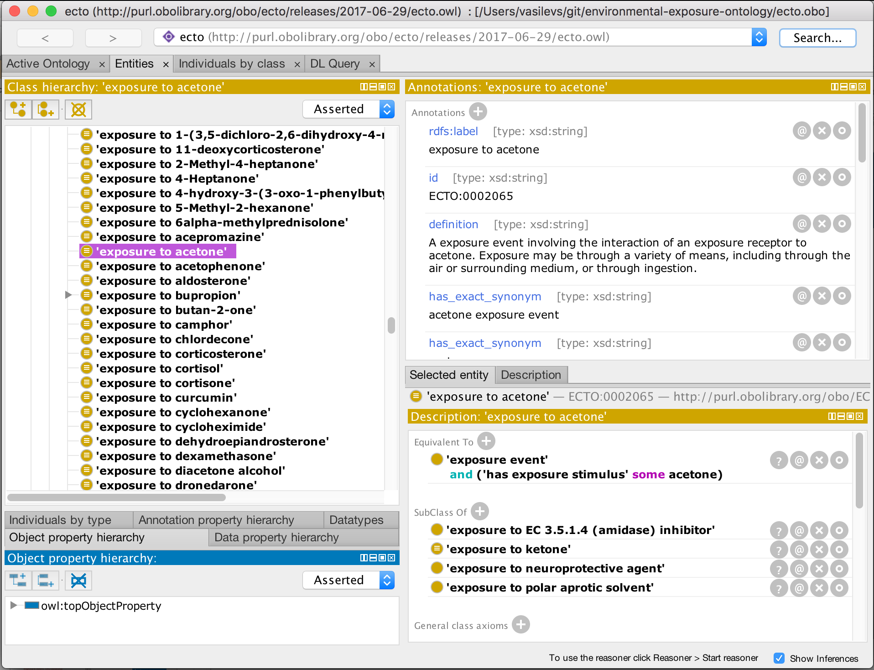
ECTO can be viewed and edited in Protégé
https://protege.stanford.edu/

Slide 6


Simplifying ontology editing via a spreadsheet
Dead Simple Ontology Design Patterns (DOSDP)
Editing OWL ontologies requires specifying OWL design patterns
Patterns are specified in the subset of YAML that can be converted to JSON
Can be used to:
Generate documentation
Generate new terms
Retrofit old terms
Allows for reuse of patterns
https://github.com/dosumis/dead_simple_owl_design_patterns

Slide 7
DOSDP Mapping in the background
pattern_name: exposure_to_chemical
classes:
exposure event: ExO:0000002
chemical entity: CHEBI:24431
relations:
has exposure stimulus: RO:0002309
vars:
stressor: “ ’chemical entity’ “
name:
text: "exposure to %s"
vars:
- stressor
annotations:
- property: oio:hasExactSynonym
text: " %s exposure"
vars:
- stressor
def:
text: "A exposure event involving the interaction of an
exposure receptor to %s. Exposure may be through a
variety of means, including through the air or surrounding
medium, or through ingestion."
vars:
- stressor
equivalentTo:
text: "'exposure event' and 'has exposure stimulus' some %s"
vars:
- stressor
Acetone exposure
Acetone exposure
A exposure event involving the interaction of an exposure receptor to acetone. Exposure may be through a variety of means, including through the air or surrounding medium, or through ingestion."
Exposure to acetone
'exposure event'
and ('has exposure stimulus' some acetone)
https://github.com/EnvironmentOntology/environmental-exposure-ontology/tree/master/src/patterns

Slide 8

INCA Form
WEB APPLICATION
Deployed as a static website
Can view and edit spreadsheet formatted data
Autocomplete and selection from semantically associated ontologies and dictionaries
FORMAT
Supports formats:
TSV, Tab-Separated Values
CSV, Comma-Separated Values
Collectively referred to as XSV in software and documentation
https://github.com/INCATools/table-editor
Notes:
Icons from:
Il Capitano – Noun project
Costa Galaktionov, RU – Noun Project

Slide 9
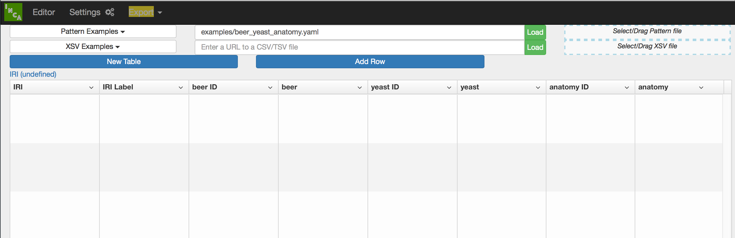



Ontology magic
Terms are constrained by the DOSDP
CHEBI ID
CHEBI Label
ECTO:0002065
exposure to acetone
CHEBI:15347
Acetone
ECTO:0001782
exposure to isopropanol
CHEBI:17824
Isopropanol
ECTO:0000243
exposure to ethanol
CHEBI:16236
Ethanol
Users edit the CSV
Ontology IRIs are auto-filled
Notes:
User edits CSV, with ontology IRIs filled in by autocomplete.

